Slide 1
BUDGET SALES ANALYSIS
BY,
NANDANA GRACE JOHNY

Slide 2
Project Details
Project Title | Budget Sales Analytics
Technologies | Data Science
Domain | Retail & Sales

Slide 3
Problem Statement
Our "Domain Sale" process is structured to help potential buyers purchase the domain they want immediately without the hassle of contacting the seller directly.
A seller lists a domain for sale at a specific price in our Marketplace. An interested buyer sees this domain for sale and decides to buy it.

Slide 4
Objective
The goal of this project is to analyze the sales budget data, extract necessary information about Customers and Product based on combination of features and to make dashboard to review the performance of the company.

Slide 5
Tools Used
Microsoft Excel
Microsoft Power BI
Details of Data
Budget
Sales
Product
Customer
Territories

Slide 6
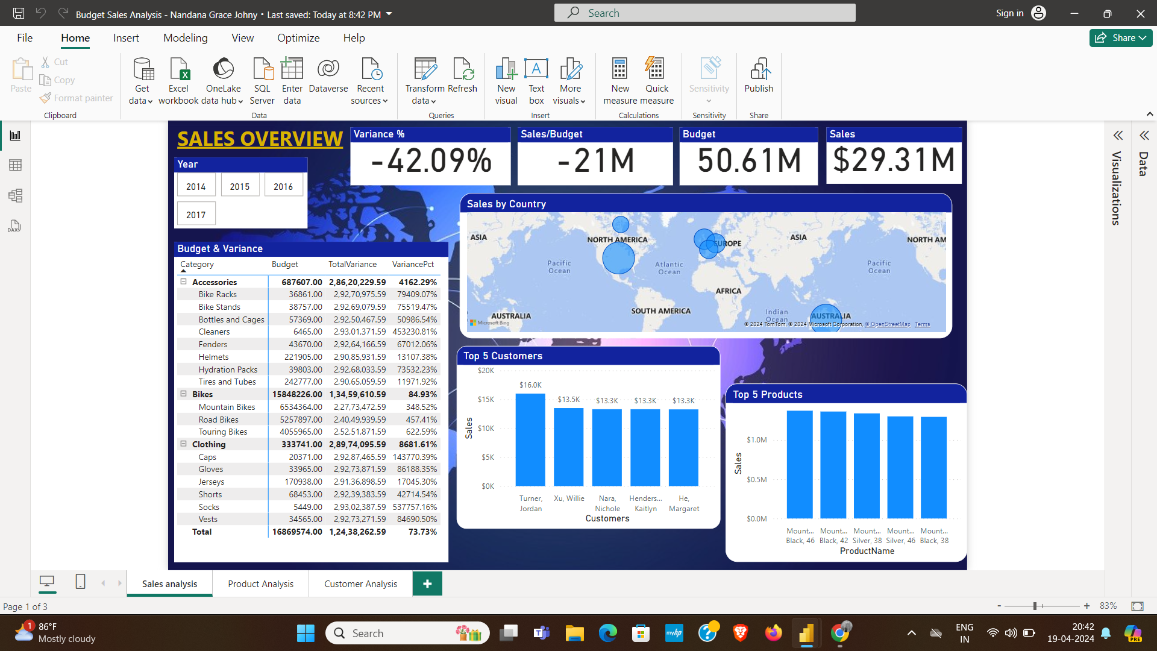
Insights

Slide 7
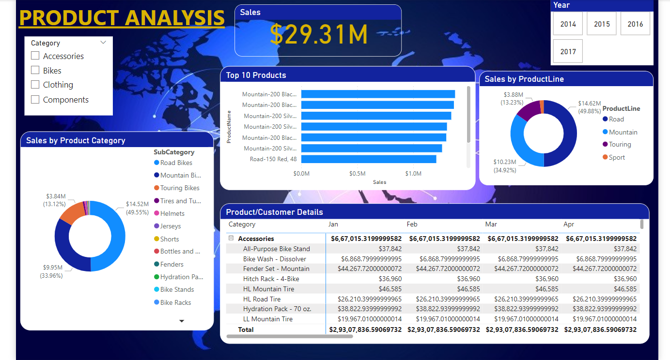

Slide 8
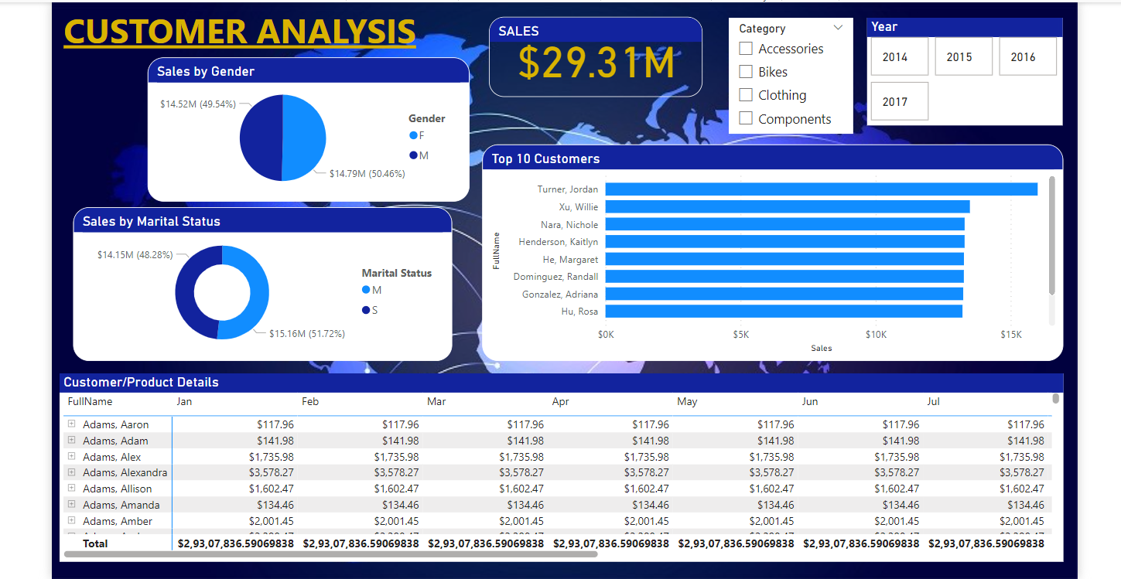

Slide 9
Conclusion
The United States has the highest sales of around 93M.
Road Bikes has the highest sales of 49.55%.
Majority of customers are female around 50.46%.
Highest sale by product line is Road around 49.88%.
Variance percentage includes -42.09%

Slide 10
THANK YOU

